Slide 1
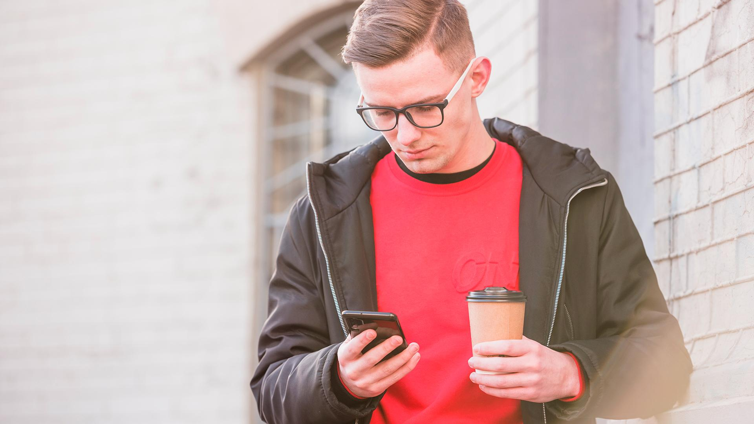

StopThePress!
App
A digital app design created by Klint McLaughlin at
the University of Texas at Dallas

Slide 2
What is StopThePress! App?
01
The Design Process Overview
02
App’ Conceptual Journey and Development
03
A Day In the Life
04
SUMMARY
Developer Bio
05
Objective and Description of our app proposal
How we came up with the app and how we created it
App’s Design and Brand Identity from the beginning to the working prototype
What an average “day in the life” user experience would be
App developer Bio

Slide 3
What is StopThePress!?
The StopThePress! app was designed with the world in mind. It’s objective from the beginning stages was to filter through all the sensationalized and false news stories on the web to make the lives of the users easier.
The app holds no political agenda or motive, and it’s designed to be as minimalist and simplistic as possible so users should have as little interaction as possible with the app itself while the app does all the heavy lifting in the background.

Slide 4
The Design Process Overview
Establish Requirements
How can an app best filter through news posts on social media platforms so that users feel empowered and in control of their online experience?
New-Use Scenarios
A grandparent looking to reconnect with family and friends online without feeling overwhelmed from world events.
Final Design Parameters
The app must contain as little user interaction and setup as possible while also assisting the user.
StopThePress! App Design
Design Exploration
The app itself has been condensed down to just include it’s settings. The actual app interaction will take place throughout user experience on social media platforms.
Proof of Concept
Final GUI designs
Final Design Specification
A finished prototype that lays out the user’s experience and is ready to be programmed.

Slide 5



User Research
LAURA PATTERSON
“There so much talk about fake news and stories on my facebook feed about politics, this isn’t what I signed up for!”
JENNA SMITH
“I just want to be able to stay in touch with friends and colleagues online without being bombarded with news stories
JOHN STEVENS
“I used to be able to understand what was going on in the world. But now I hear at least 5 different stories about our federal government. I don’t even know who to believe anymore!!!”

Slide 6
User Research In-Depth
Activities
  People want to browse news AND social media without sensationalized information
  People want ability to control when, where, and what they view
Environment
  Users typically view news during the morning and evening
  When not actively checking news, users typically browsed social media on-the-go or during downtime in their day.
Interactions
  People posted news stories on their social media feed, whether others wanted to see it or not
  People who did want to interact with news stories, also wanted to discuss with others about the story
Objects
  We found people browsing news stores from their smartphones, laptops, desktops, and occasionally on their TV.
Users
  We found that Teens and Young Adults make up the majority of social media users, however elders were highly engaged with the social media app Facebook compared to all others.

Slide 7
User Insights
Problems
Solutions
“UN”SOCIAL MEDIA
TOO MUCH INFO
Users felt overwhelmed with all the different news stories they encountered online, with each source carrying a different tale of the event in question.
Users felt as if social media was anything but social. They spent more time on average reading advertisements and news compared to interacting with other people.
SIMPLICITY
UNBIASED
Create an almost “hands-free” app that declutters other social media apps and helps users navigate the heaps of misinformation online.
StopThePress! is designed with the user in mind. The app will take no preference of politics or news source, and will act on any outliers and/or sensationalized sources of information.

Slide 8
User Insights In-Depth
Activities
  App should auto-blur any news article and provide an overlay that indicates if an article is true, false, and/or sensationalized.
Environment
  With users actively checking news stories in the morning and evening, we anticipate the most usage of app resources to occur during those times and looked to streamline and minimize as much of the app as possible when in heavy usage.
Interactions
  Users typically logged into social media to check in and interact with friends, not news stories. So we decided to focus on mainly filtering out any news articles, with fact-checking and identifying sensationalized wording as a secondary function of the app.
Objects
  Users tended to use mostly their smartphones for social media needs, so we decided to focus on creating a smartphone app.
Users
  We found that elders were the most susceptible to online scams of any age group, so StopThePress! has been designed with them being the target audience and user of the app.

Slide 9
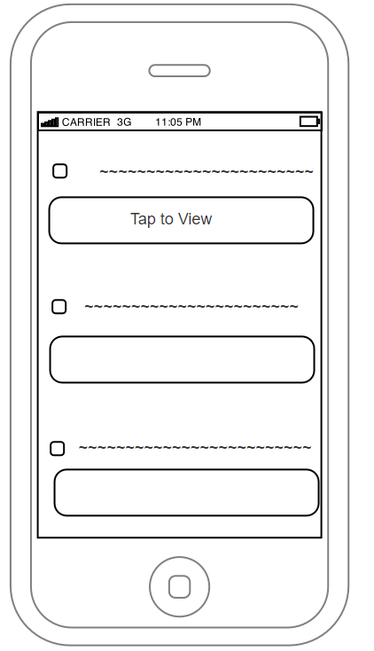
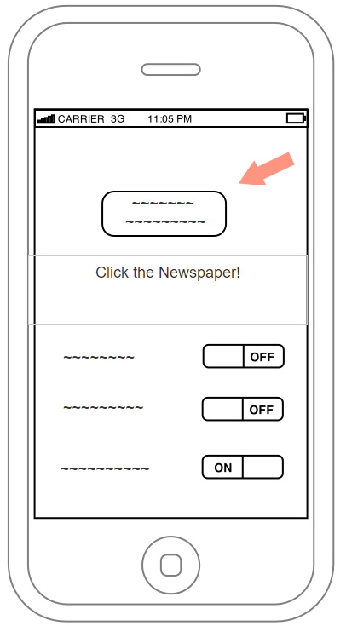
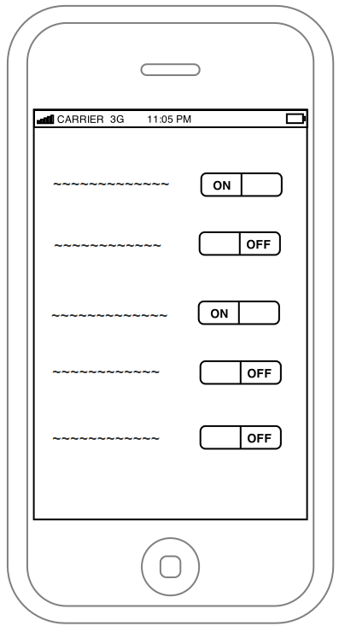
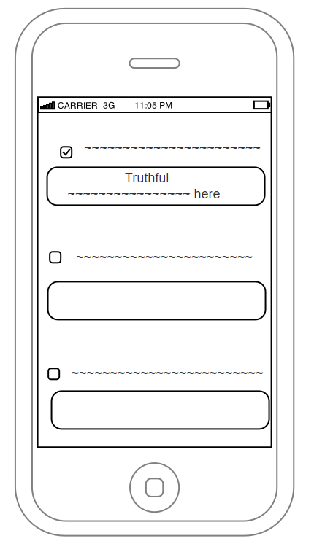
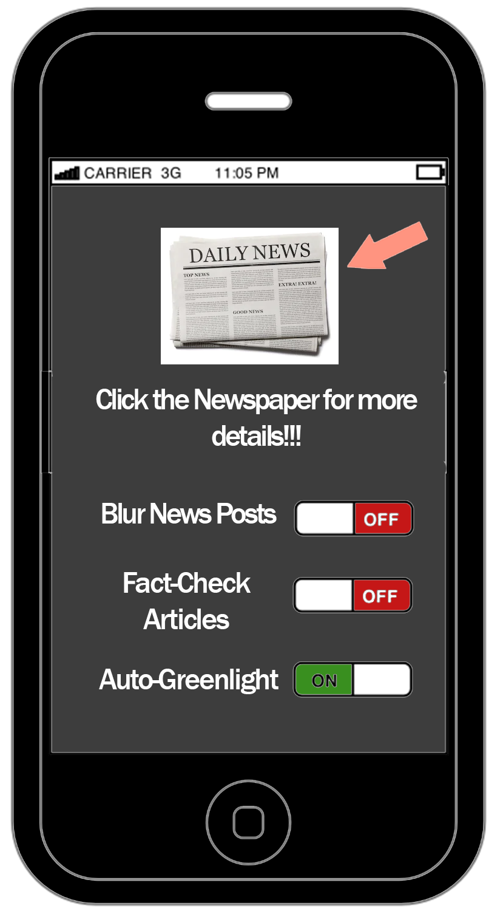
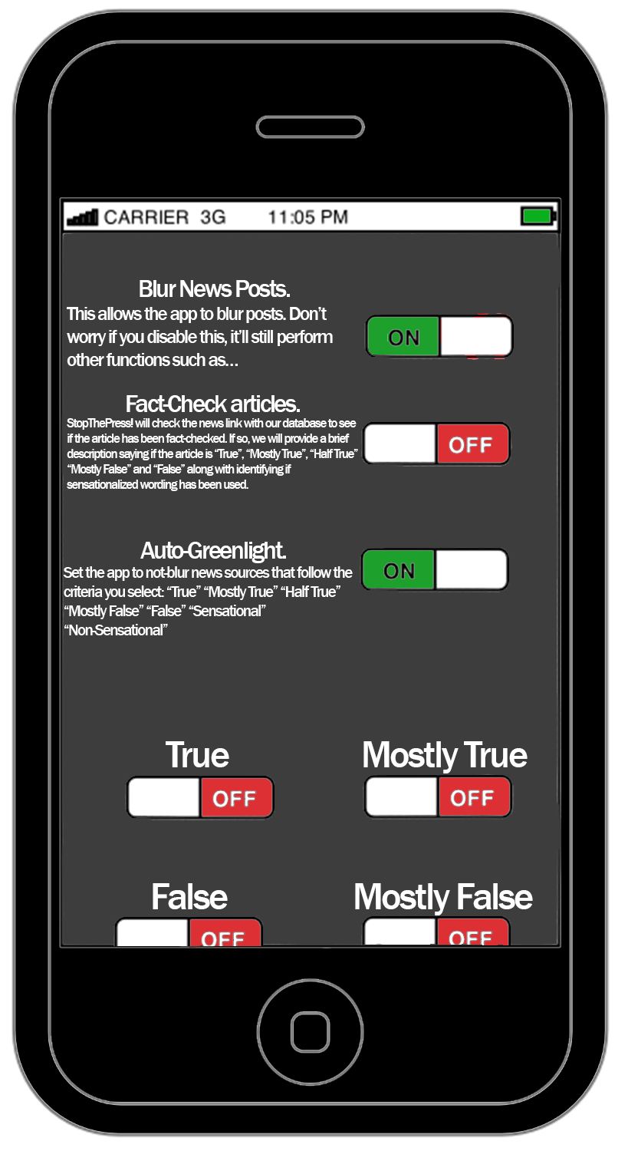
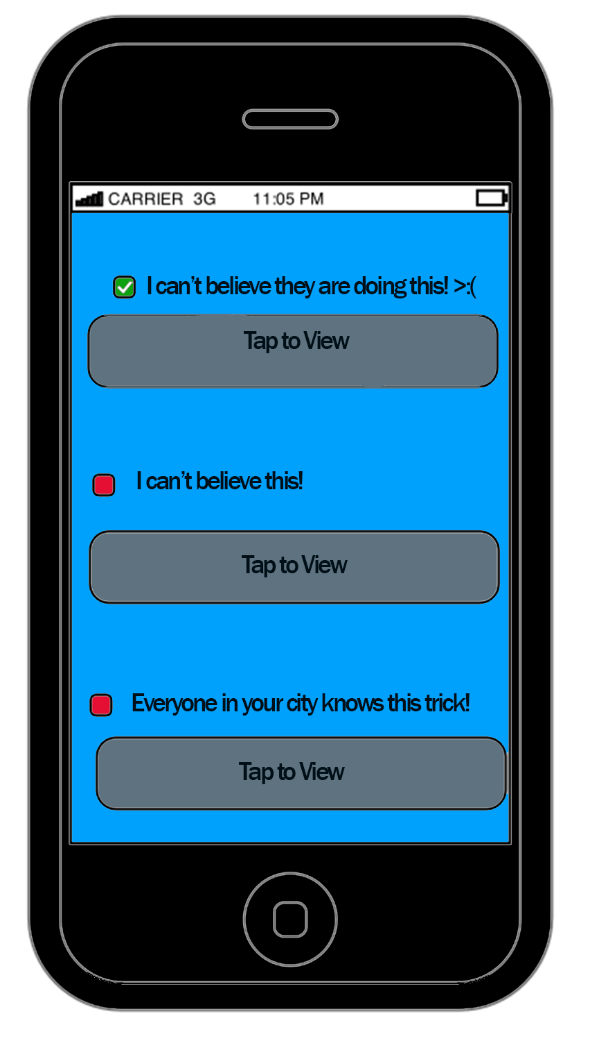

Proposed App Concepts
Initial Stages
View from Social Media
Inside the App
Initial wireframes were created to meet the Final Design Parameters and to lay the foundation for your New Use Scenarios.
  These wireframes were later enhanced with some low-res artwork to help test users have a better “feel” for the app.
Low-Res Art

Slide 10
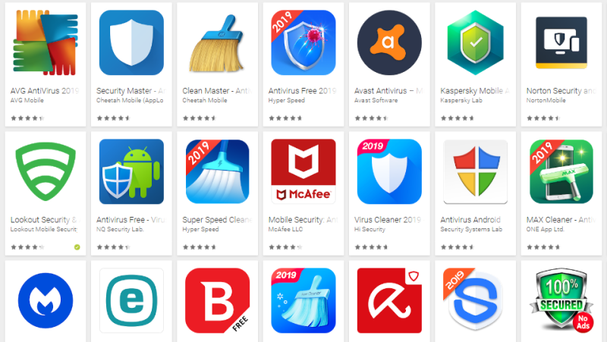
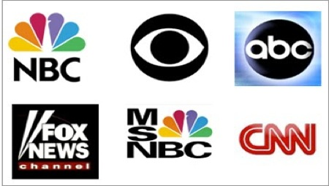
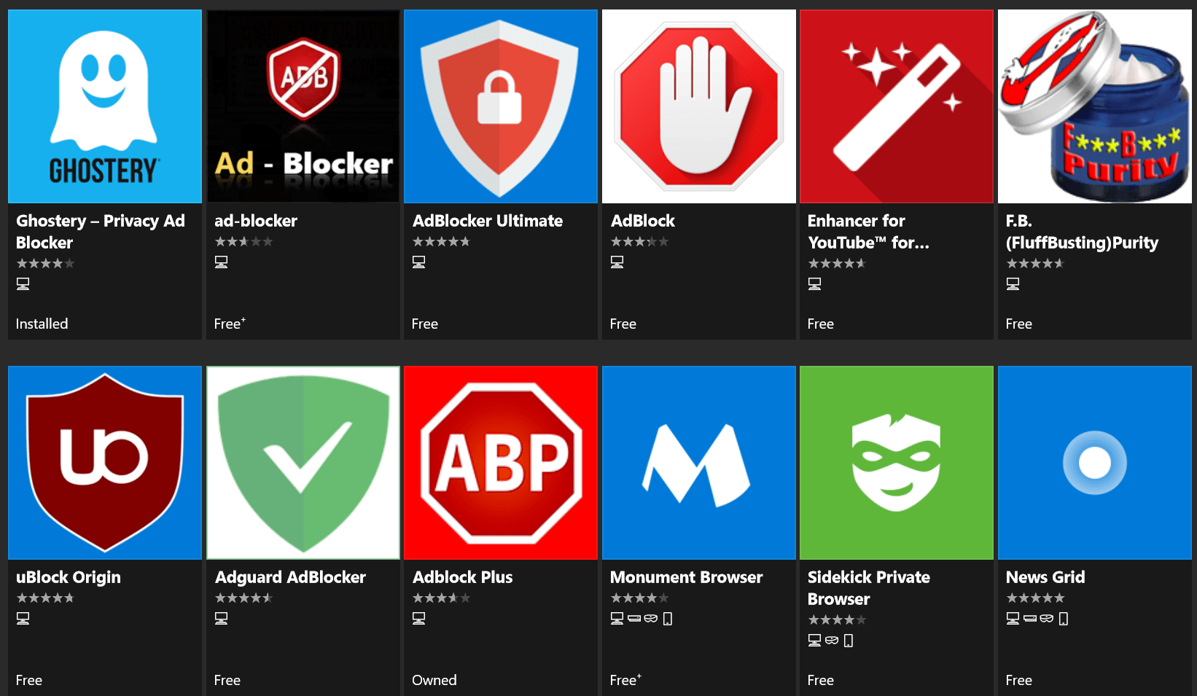


Brand Design Development
Initial Stages
Brand Mark Development
With our app’s wireframes and artwork underway, research shifted focus into our brand’s identity.
Research was done on various ad-blockers, anti-virus, and news media to help guide our brand’s logo and message: Stopping Fake News.
Development was made into incorporating this message both into our logo and into our App’s name.
App Name Development
PRESS-STOP
Stop The Presses
StopThe
Press!
NewsBlock
No More News
No More Stories

Slide 11
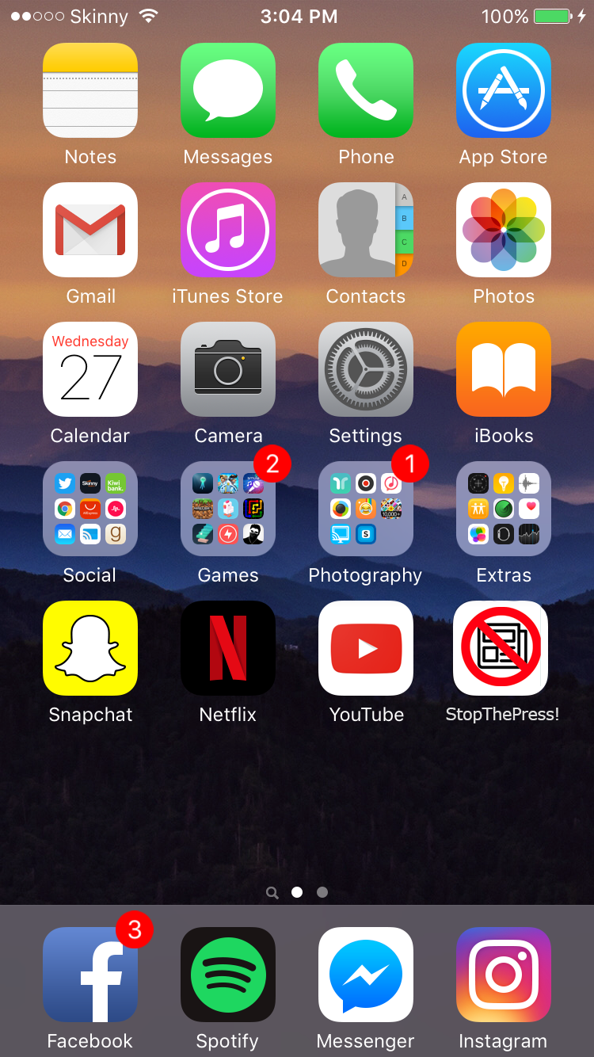
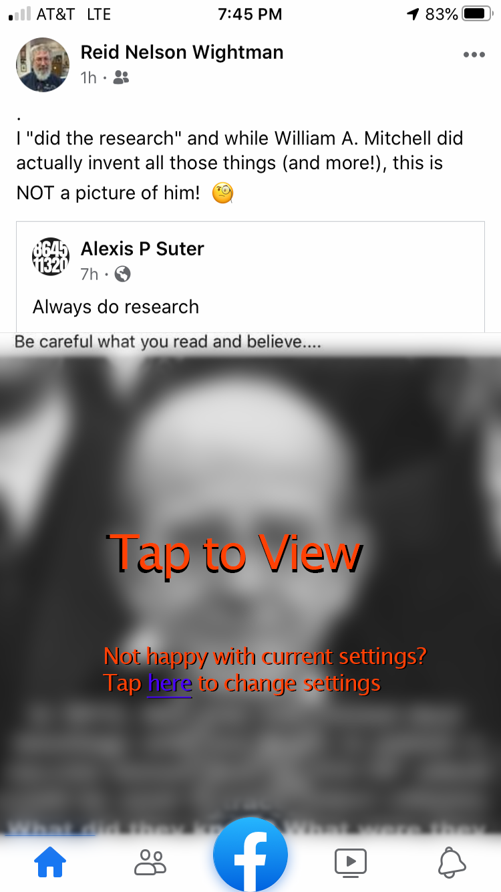
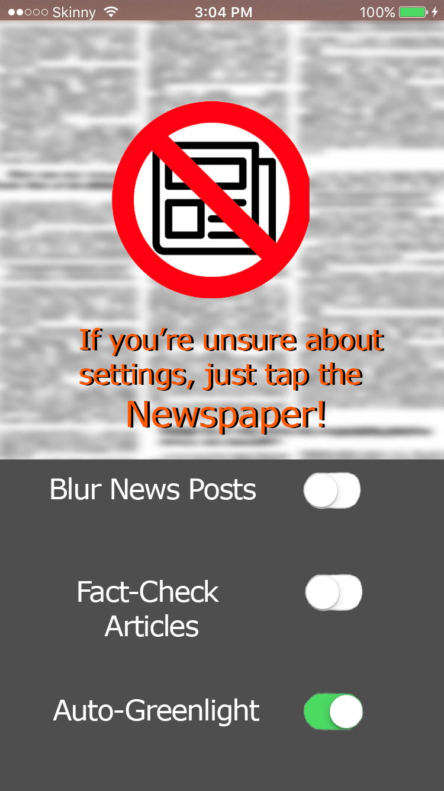
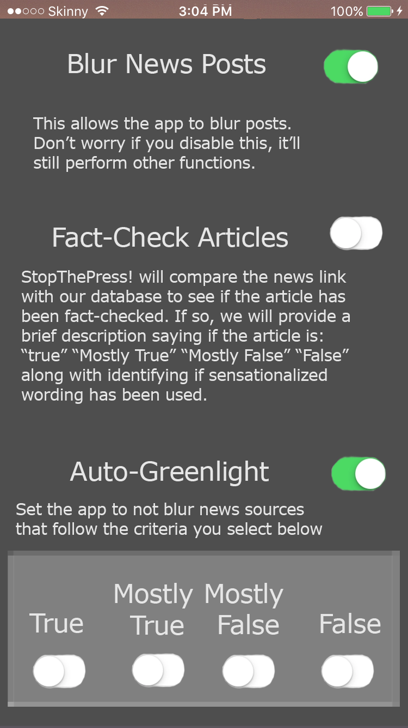
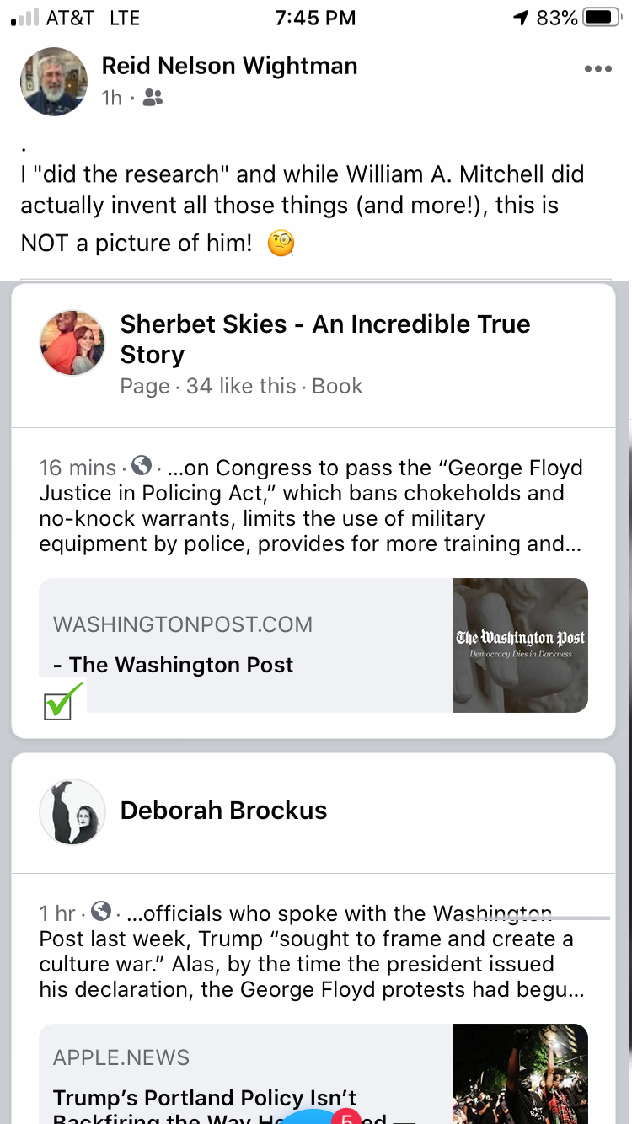
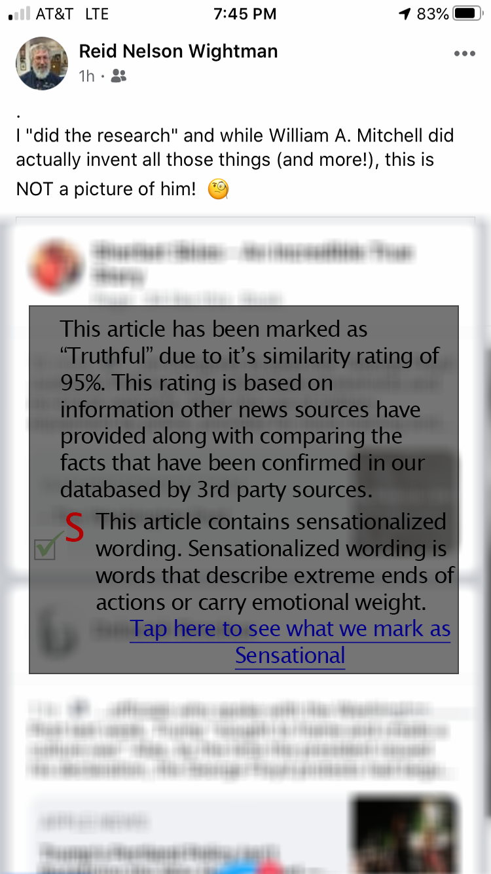
Final Design
Final Touches
High-Res Images
After designing our brand’s identity and logo and creating our lew-res screen art, we are now ready to put it all together into High-Res artwork.
With the creation of these High-Res images, all that is left is to test it out in our “Day in the Life” script and create a prototype to test out the feel as we walk through the script.

Slide 12
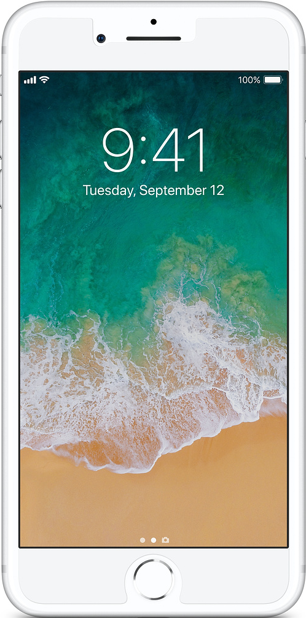
A Day in John’s Life
[01.00] Main Screen
[01.01]John unlocks his iPhone and opens up the Facebook App.
[01.02] The first post he sees is blurred and in the center of this blur is the words, “Tap to View” with a subtext prompting him to adjust settings by tapping ”here“ or open the app.

Slide 13
A Day in John’s Life
[02.00] App Screen
[02.01] John taps “here” to edit the settings for the StopThePress! App.
[02.02] The iPhone opens and switches over to the StopThePress! App.

Slide 14
A Day in John’s Life
[02.00] App Screen
[02.03] On the screen John is met with a newspaper graphic with text and sliders below to edit the settings.
[02.04] On the Newspaper graphic there’s a text above, “If you’re unsure about settings, just tap the image”. John, definitely unsure, taps the newspaper image.

Slide 15
A Day in John’s Life
[03.00] App Settings
[03.01] A window opens that explains each of the settings.
[03.02] Blur News Posts. This allows the app to blur posts. Don’t worry if you disable this, it’ll still perform other functions such as…
[03.03] Fact-Check articles. Checks the news link with our database to see if the article has been fact-checked. If so, we will provide a brief description saying if the article is “True”, “Mostly True”, “Half True” “Mostly False” and “False” along with identifying if sensationalized wording has been used.
[03.04] Auto-Greenlight. Set the app to not-blur news sources that follow the criteria you select:
  “True” “Mostly True” “Half True” “Mostly False” “False” “Sensational” “Non-Sensational”

Slide 16
A Day in John’s Life
[04.00] Social Media Screen
[04.01] After going through these screens, John decides that’s enough messing around in the app and goes back to browsing Facebook.
[04.02] He is now greeted by his friend’s post which is shows a Washington Post article about the arrest of CNN reporters at the George Floyd Protests. He wondered how could this be truthful? The app surely must be broken or have a hidden agenda of some sorts.

Slide 17
A Day in John’s Life
[05.00] Social Media Interaction
[05.01] Conveniently enough, when John taps on the Truth checkmark a small excerpt opens up with text that explains why the app marked it truthful.
[05.02] It shows a 95% similarity score to others news articles along with being fact-checked by various sources.
[05.03] John still confused decides to tap on the red “S” that marks the article as sensationalized. Here, another excerpt opens up that a majority of the words used in the article match sensational words in StopThePress!’s database. There’s even an option to check the database to see what words count as sensational.

Slide 18
A Day in John’s Life
[06.00] Ending In-App Usage
[06.01] Feeling satisfied and no longer confused, John taps the “x” in the top right hand corner of the excerpt and continues to browse Facebook.
[06.02] Now, John was able to scroll through his feed with the occasional “Factual” news article while he got to focus more on keeping up with his family growing up.
The End

Slide 19
Prototype
You can test out our working prototype at the following link:
https://xd.adobe.com/view/ed205439-304c-4073-81f6-a1748d7c89af-b873/

Slide 20
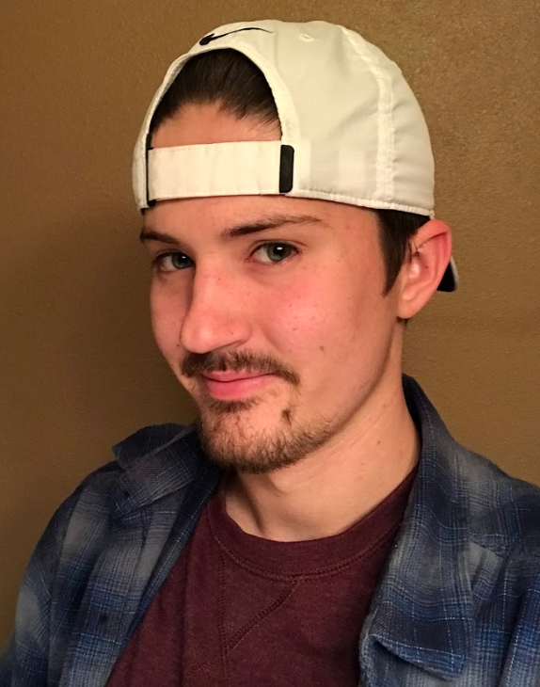
Meet the Developer
Klint McLaughlin
Klint McLaughlin is a senior at University of Texas at Dallas. He plans to graduate this upcoming Fall of 2020 with a Bachelor of Arts degree with the Arts, Technology, and Emerging Communications program in the Design and Production pathway.
Senior at University of Texas at Dallas

